Slide 1
GENERATIVE AI Anna AI

Slide 2

Introduction Overview : Anna AI is a generative AI system designed to interact with users through natural language queries and image inputs, providing intelligent responses powered by advanced AI models. The system is built using Vite React for the frontend with a Node.js/Express.js backend, and another interface is implemented using Streamlit with a Python backend Key Features:
Chat-based interaction images, audio, video, and files.
Personalized settings that allow system with real-time AI responses.
Media upload functionality, supporting users to adjust the interface's appearance and behavior.
Voice input for speech-to-text conversion and AI-powered search functionality.

Slide 3

Problem Definition
Challenges of Current Systems
The Challenge Addressed By Anna AI Is To Create A System That Can Seamlessly Manage Text And Image Inputs, Handle Complex Ai-driven Responses, And Provide An Intuitive Interface For Users.
Generative Ai Has The Potential To Assist Users In A Variety Of Tasks, But Integrating Multiple Frameworks And Ensuring Consistent Performance Across Diverse User Scenarios Presented A Significant Technical Challenge.

Slide 4
Objective
The primary objective of this project is to build an interactive AI system that Offers real-time, AI-generated responses for both text and image-based queries.
Provides a responsive, user-friendly interface for effective interaction with the AI.
Leverages a powerful backend to handle data storage and complex AI processing, ensuring scalability and high performance.

Slide 5
Survey / Ideas
This project draws on state-of-the-art AI technologies such as Google Generative AI and OpenAI.
The frontend architecture leverages Vite React to build a fast and scalable UI, while Streamlit allows for quick development and prototyping of the AI interface.
AI-driven systems like ChatGPT and Gemini have influenced the design, inspiring the project to focus on real-time interaction and flexibility in AI responses.

Slide 6
System Architecture
Login page :
The login page provides basic authentication through login and sign-up options. Users must enter their credentials (email/username and password) to access the platform.
Explore Page :
The explore page includes the following key elements :
Model parameters
Reset conversation
Multimedia uploads
Navigation Bar :
Settings
Print
Return
Main Page :
Side Bar
New chat
Chat history
Activity
Main Interface
Contains a search box for quick navigation, an Explore Page button for further customization, and a Logout button for secure exit from the platform.

Slide 7
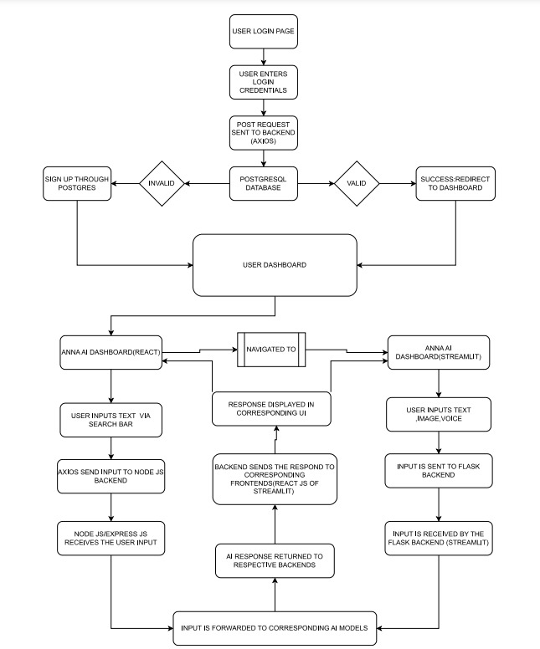
SYSTEM ARCHITECTURE

Slide 8
Detailed Design
The Anna AI system is carefully designed to provide a smooth and intuitive user experience across both React (Vite) and Streamlit interfaces, with seamless integration of AI models for real-time interaction. This section delves deeper into how the frontend communicates with the backend, how inputs are processed, and how responses are generated by the AI models.
I .React (Vite) Frontend with Node.js (Express.js) Backend:
*Users interact via a search bar or image upload.
*For text inputs, the query is wrapped in a JSON object and sent to the backend using Axios.
*The Node.js backend processes the request and forwards it to the AI model (e.g., OpenAI or Google AI).
*The AI generates a response, which is returned to the frontend and displayed in real time.For image inputs, the image is converted to Base64 and sent to Anthropic for processing.
*The image data is then sent to the AI model for recognition or analysis.The result is sent back to the frontend and displayed alongside the text responses.Error handling is implemented to manage failed requests or invalid inputs

Slide 9
DETAILED DESIGN
II .Streamlit Frontend with Python (Flask) Backend:
*Users input queries or upload images directly within the minimalist interface.
*For text inputs, the input is passed through a form and sent to the Flask backend.
*The backend processes the query by interacting with an AI model to generate the response, which is then displayed on the UI.
*For image inputs, the image is encoded into Base64 and sent to Anthropic for analysis. The processed data is then returned as an AI-generated response.
*The Streamlit interface shows the response in real-time.Both interfaces ensure seamless AI interactions, with text and image inputs handled efficiently across the two platforms, offering dynamic and real-time feedback.

Slide 10
Tools and Technologies Used
Frontend : Vite React: Fast, modern framework for building web applications.
Streamlit : Used to quickly develop a user interface for AI experimentation.
Backend : Node.js with Express.js: Manages server-side operations, handling requests and responses.
Python : Responsible for AI processing, especially for handling image recognition and natural language understanding.
Database : PostgreSQL stores user inputs, AI responses, and metadata.
AI Models : Google Generative AI API and OpenAI for real-time AI responses.
Libraries : dotenv, requests, Flask, PostgreSQL connectors for backend operations and API handling

Slide 11
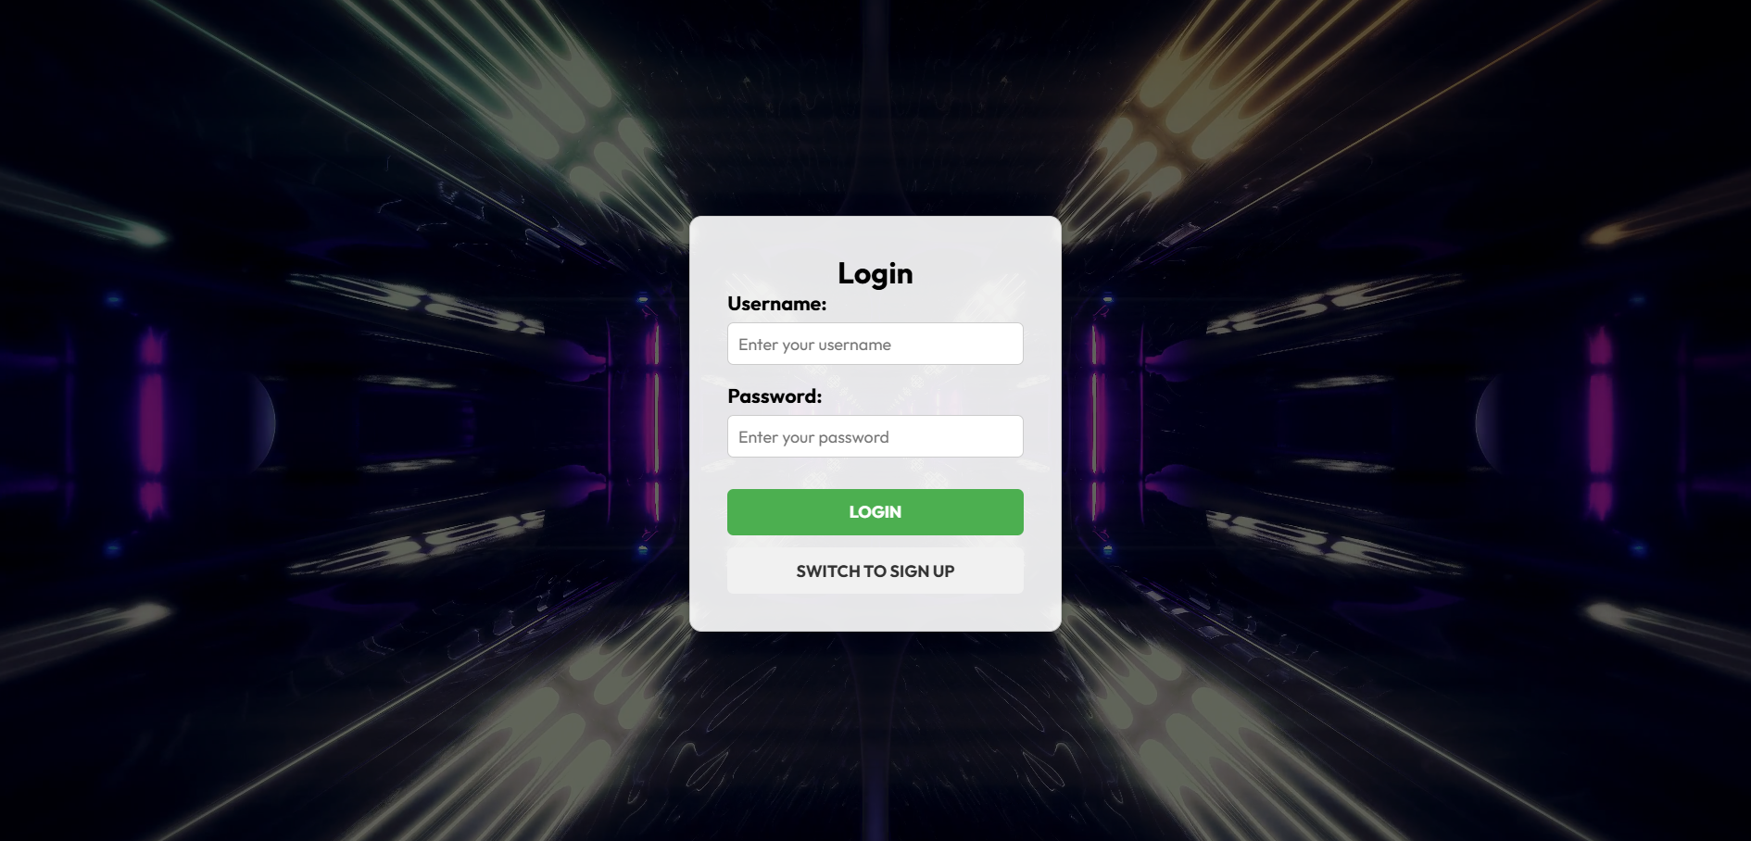
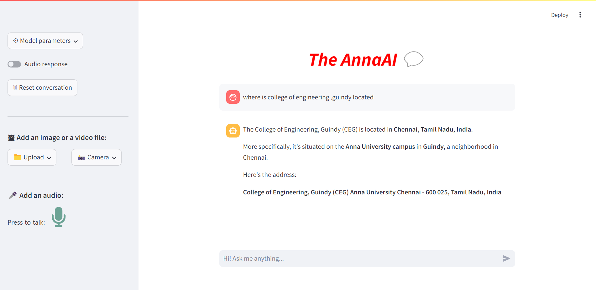
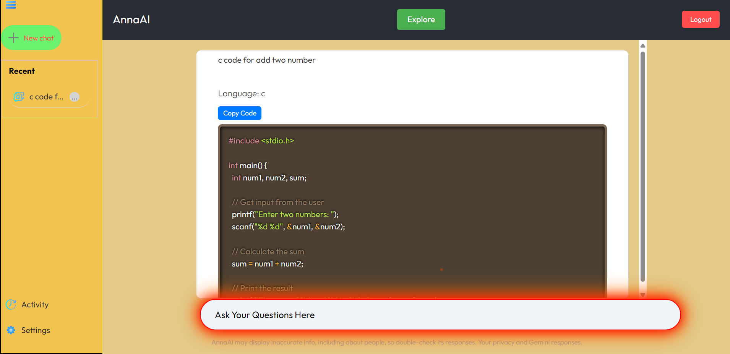
Screenshots

Slide 12
Results and discussions
The project successfully demonstrates the use of generative AI to provide intelligent, real-time responses in a user-friendly manner.
The system handles both text and image inputs efficiently, and the architecture allows for scalability and further improvements.
The project bridges the gap between complex AI models and practical, interactive applications that can be used across different domains. User feedback indicates a smooth experience with quick AI responses, making the system suitable for a variety of real-world use cases.

Slide 13

References
Vite React Documentation
Node.js/Express.js Documentation
PostgreSQL Official Site
Streamlit DocumentationGoogle
Generative AI API Documentation
OpenAI API Documentation
Python Requests Library

Slide 14
Thank you

Slide 15
BY
1.SHRINIGASH
2.VINITH V - 2022115083
3.DIVAKAR S - 2022115110

